Slide 1
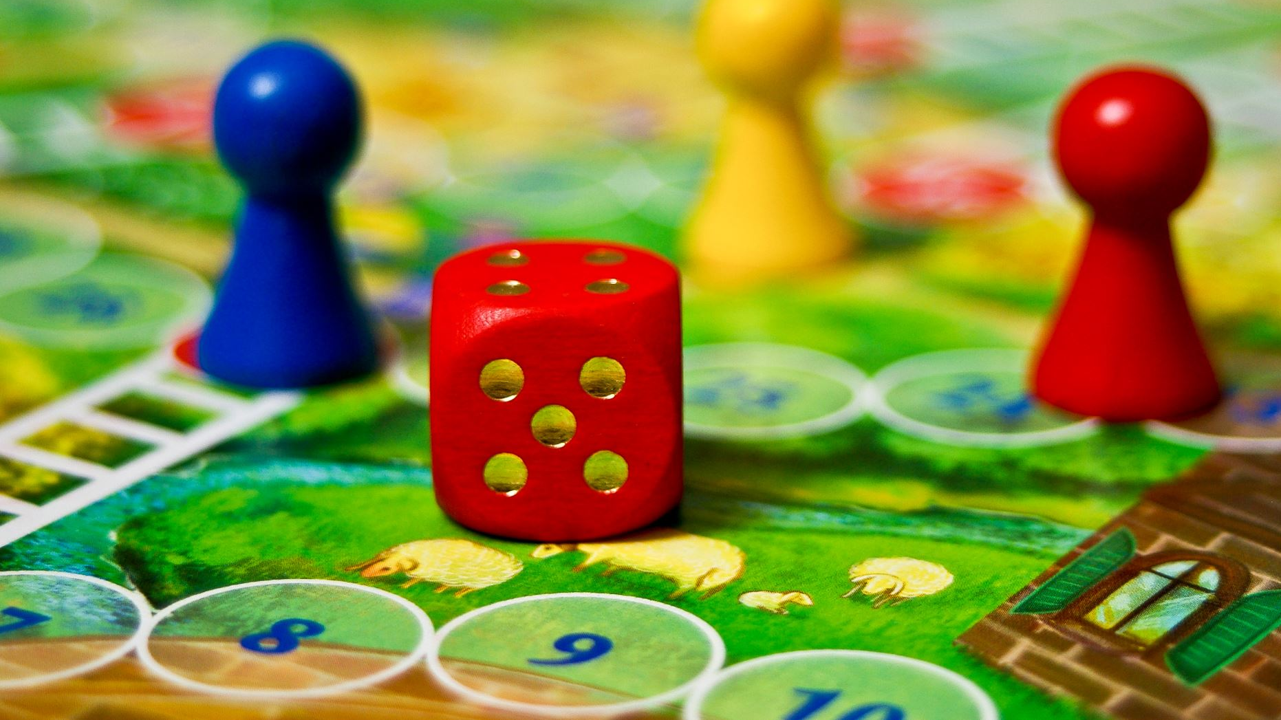
Matthew’s Journey: Godot Game Development
From Team NoGrads

Slide 2
Team NoGrads // Godot Game Project
Robert Dallessandris
BS Computer Science Senior
Team Role: Gameplay and Mechanics Developer
Virginia Richards
BS Computer Science Senior & Math minor
Team Role: Systems and Gameplay UI Developer
Josiah Yount
BS Computer Science Senior, Cybersecurity Certificate
Team Role: Narrative and Music Developer
Cara Zozokos
BA Computer Science, Cybersecurity Certificate
Team Role: Level and Menu UI Developer

Slide 3
Our Pitch
Godot programmed videogame named Matthew's Journey
2D top down, Zelda-like adventure game
With real-time hack and slash combat
2D pixel art, sound, & music will be outsourced
None of the team has made a game of this scope before
Notes:
Revise!!!!

Slide 4
Overview
Outline of presentation
Architecture overview figure
Notes:
Revise!!!!

Slide 5
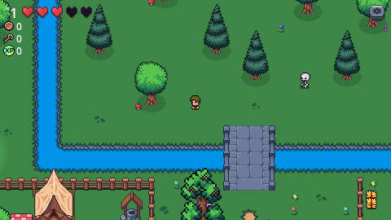
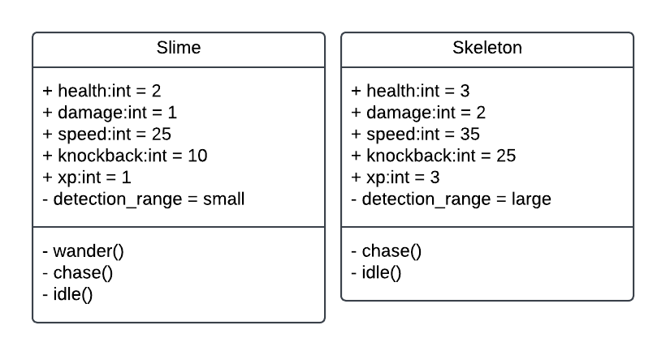
Combat
User Story: As a player, I want to be able move my character and swing my sword to fight enemies.
Requirement: There shall be enemies that are different enough to require different tactics.
Design:
Slimes: small detection zone, slow speed, low damage, low knockback, low xp, low health. They wander around until player gets in range then chase them. Meant to be an easy, common enemy.
Skeleton: Large detection zone, fast speed, high damage, high knockback, high xp, high health. They stand still until player gets in range then chase them. Meant to be an ambush enemy that hides behind trees to surprise player.
Conclusion: Simple hack and slash combat was implemented where the player swings a sword in the direction they are facing. The, two enemy types, slime and skeleton, present different challenges to the player
Notes:
Revise!!!!

Slide 6
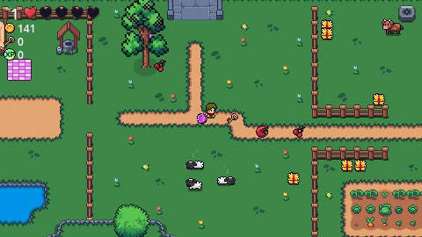
Items
User Story: As a player developer, I want elements in the environment for the player to interact with.
Requirement: There shall be items in the environment for the player to pickup
There shall be health pickups that will heal the players health
There shall be coin pickups
Design:
Conclusion: There are two types of health pickup: apple that restores 1 health, and cherry that restores all health. Coins come in 5 different denominations and the total value is tracked in the HUD.
Notes:
Revise!!!!

Slide 7
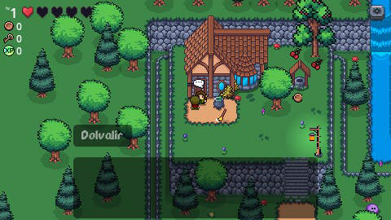
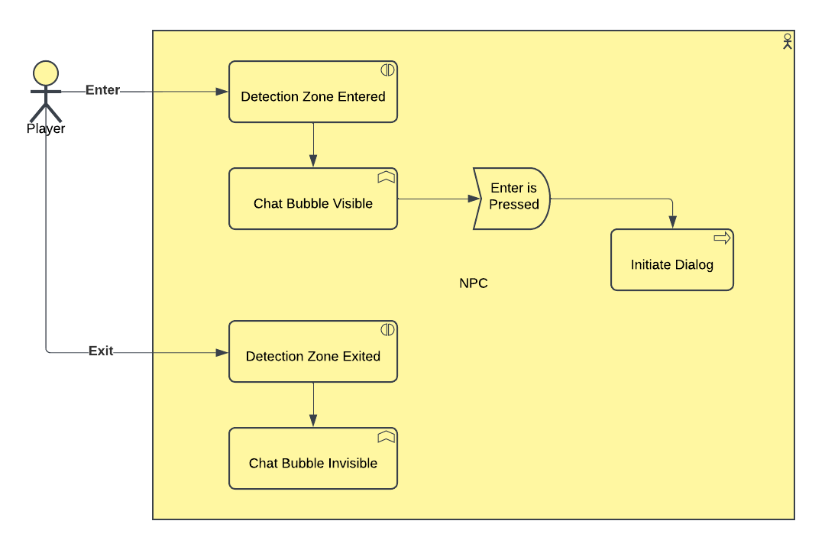
GUI
User Story: As a player, I want to interact with characters through dialogue boxes and understand how to play the game through those interactions.
Requirement: The characters shall have a dialogue mechanic.
Design: When the player approaches an npc they may talk too, a chat bubble will appear above the npc's head indicating the player is able to interact with this npc. Npc's have a detection zone around them that triggers the chat bubble icon's visibility. When a player character enters the zone the visibility is set to true, when the player exits the zone, the visibility is set to false. While within the zone, if the player presses enter, the dialog for that npc will be triggered.
Conclusion: Dialog is implemented through the Dialogic library. The player can select options when talking to an NPC that lead to differing results
Notes:
Revise!!!!

Slide 8
Map
intro at least one user store
one requirement
one design
implementation gif or figure
brief conclusion
Notes:
Revise!!!!

Slide 9
Conclusion
conclusion slide for how we thought the class as a whole (not group) went
Notes:
Revise!!!!

Slide 10
Questions?
Notes:
After 11 minutes

